Slide 1

Team Details
Team name: Ch4
Team leader name: Siddhi Shrivastava
Problem Statement:
18: Tell a Climate Story:
Over the last several decades, a huge amount of climate data from numerous sources has been collected. This data is freely available to the public, but making sense of this vast amount of data is not easy! Your challenge is to use the open-source data on the U.S. Greenhouse Gas Center website to tell a compelling story about climate change.

Slide 2

Brief about the idea : Comic style story telling with data-driven insights
- Comic-style storytelling : engaging visuals that highlights effects on planet and life
Interactive Power BI visualizations; forecasts
GHG footprint Calculator
A story that speaks the reality and measures our current state down to every tonne and inspires to make individual impact.
But a story is helpless if it can’t shake a human heart. We want to touch their hearts and make them beat with purpose to take action.
Calculate their own GHG footprint using our GHG calculator app. Based on their score our app will suggest lifestyle changes to lower their GHG emissions.

Slide 3
Opportunities
How different is it from any of the other existing ideas?
Our website Combines Comic-style storytelling + Interactive visualizations making a comic come ALIVE. Most climate-related projects focus either on science-fiction comic or pure data. The narrative is supported with real datasets.
Target audience
Young who enjoy comics, and read about important stuff but lack the technical skills to make sense of long research papers and datasets.
Those who read sci-fi comics, and research papers and want something more fun along with the technical analysis.

Slide 4
Opportunities
How different is it from any of the other existing ideas?
Phases of the story + supported with Power BI visualizations
Problems due to high GHG levels. E.g., ongoing floods in India, wildfires, drought in all parts of the world.
Sources of GHG emissions.
Effects on all life forms.
Forecasting the future of GHG trends and effects on the earth and its tenants.
Realistic approach to lower GHG levels.
After effects: status of disastrous events.
The flow of the story supported by data visualizations ensures emotional engagement with factual confirmation that all of this is not made up. THIS IS HAPPENING RIGHT NOW.

Slide 5
Opportunities
b. How will it be able to solve the problem?
Each of our team member has come across various humans who were quite unaware of the threats Earth’s current temperature is causing, casually blaming it the unpredictability of weather and never understanding the cause behind it. Education is the first step but making it accessible is the foremost.
By presenting complex climate data in a simplified, visually appealing format, we can engage a wider audience, especially those who may find raw data intimidating. Our interactive Power BI dashboards allow users to explore GHG trends, sources, and impacts, helping them understand the problem in detail.
Action: The GHG Footprint Calculator empowers individuals to measure their own contribution to GHG emissions and take actionable steps toward reducing it.

Slide 6
Opportunities
c. USP of the proposed solution
Entertainment-driven approach to present concrete solutions to tackle climate change and make an impact at individual level.
Motto is to build an emotional connection with the user and to take actions to save the only planet we have (until SpaceX launches public space services)
Unique Blend of Storytelling and Data: Using comics to narrate a data-driven story is an innovative approach, bridging the gap between education and emotional impact.
Interactive Visualizations: Power BI allows users to engage with real-time data, making the story dynamic and data-driven.
Personal Action: The GHG Footprint Calculator provides personalized recommendations, turning information into action for the user.

Slide 7
List of features offered by the solution
Engaging: Comic-style storytelling.
Technical analysis: Interactive PowerBI visualizations
Forecasting: GHG levels Forecasting with Machine learning
Actionable solutions and after-effects
App: GHG Footprint calculator (individual impact)
Updates on the current situation through APIs
Responsive layout; can be operated on all devices. (Currently desktop only)

Slide 8
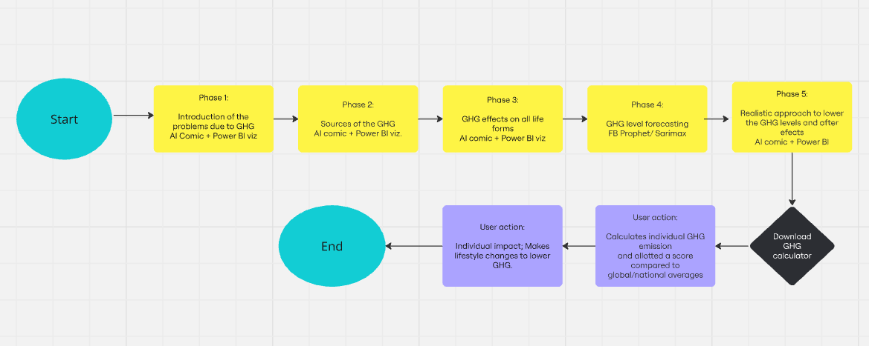
Process flow diagram or Use-case diagram

Slide 9
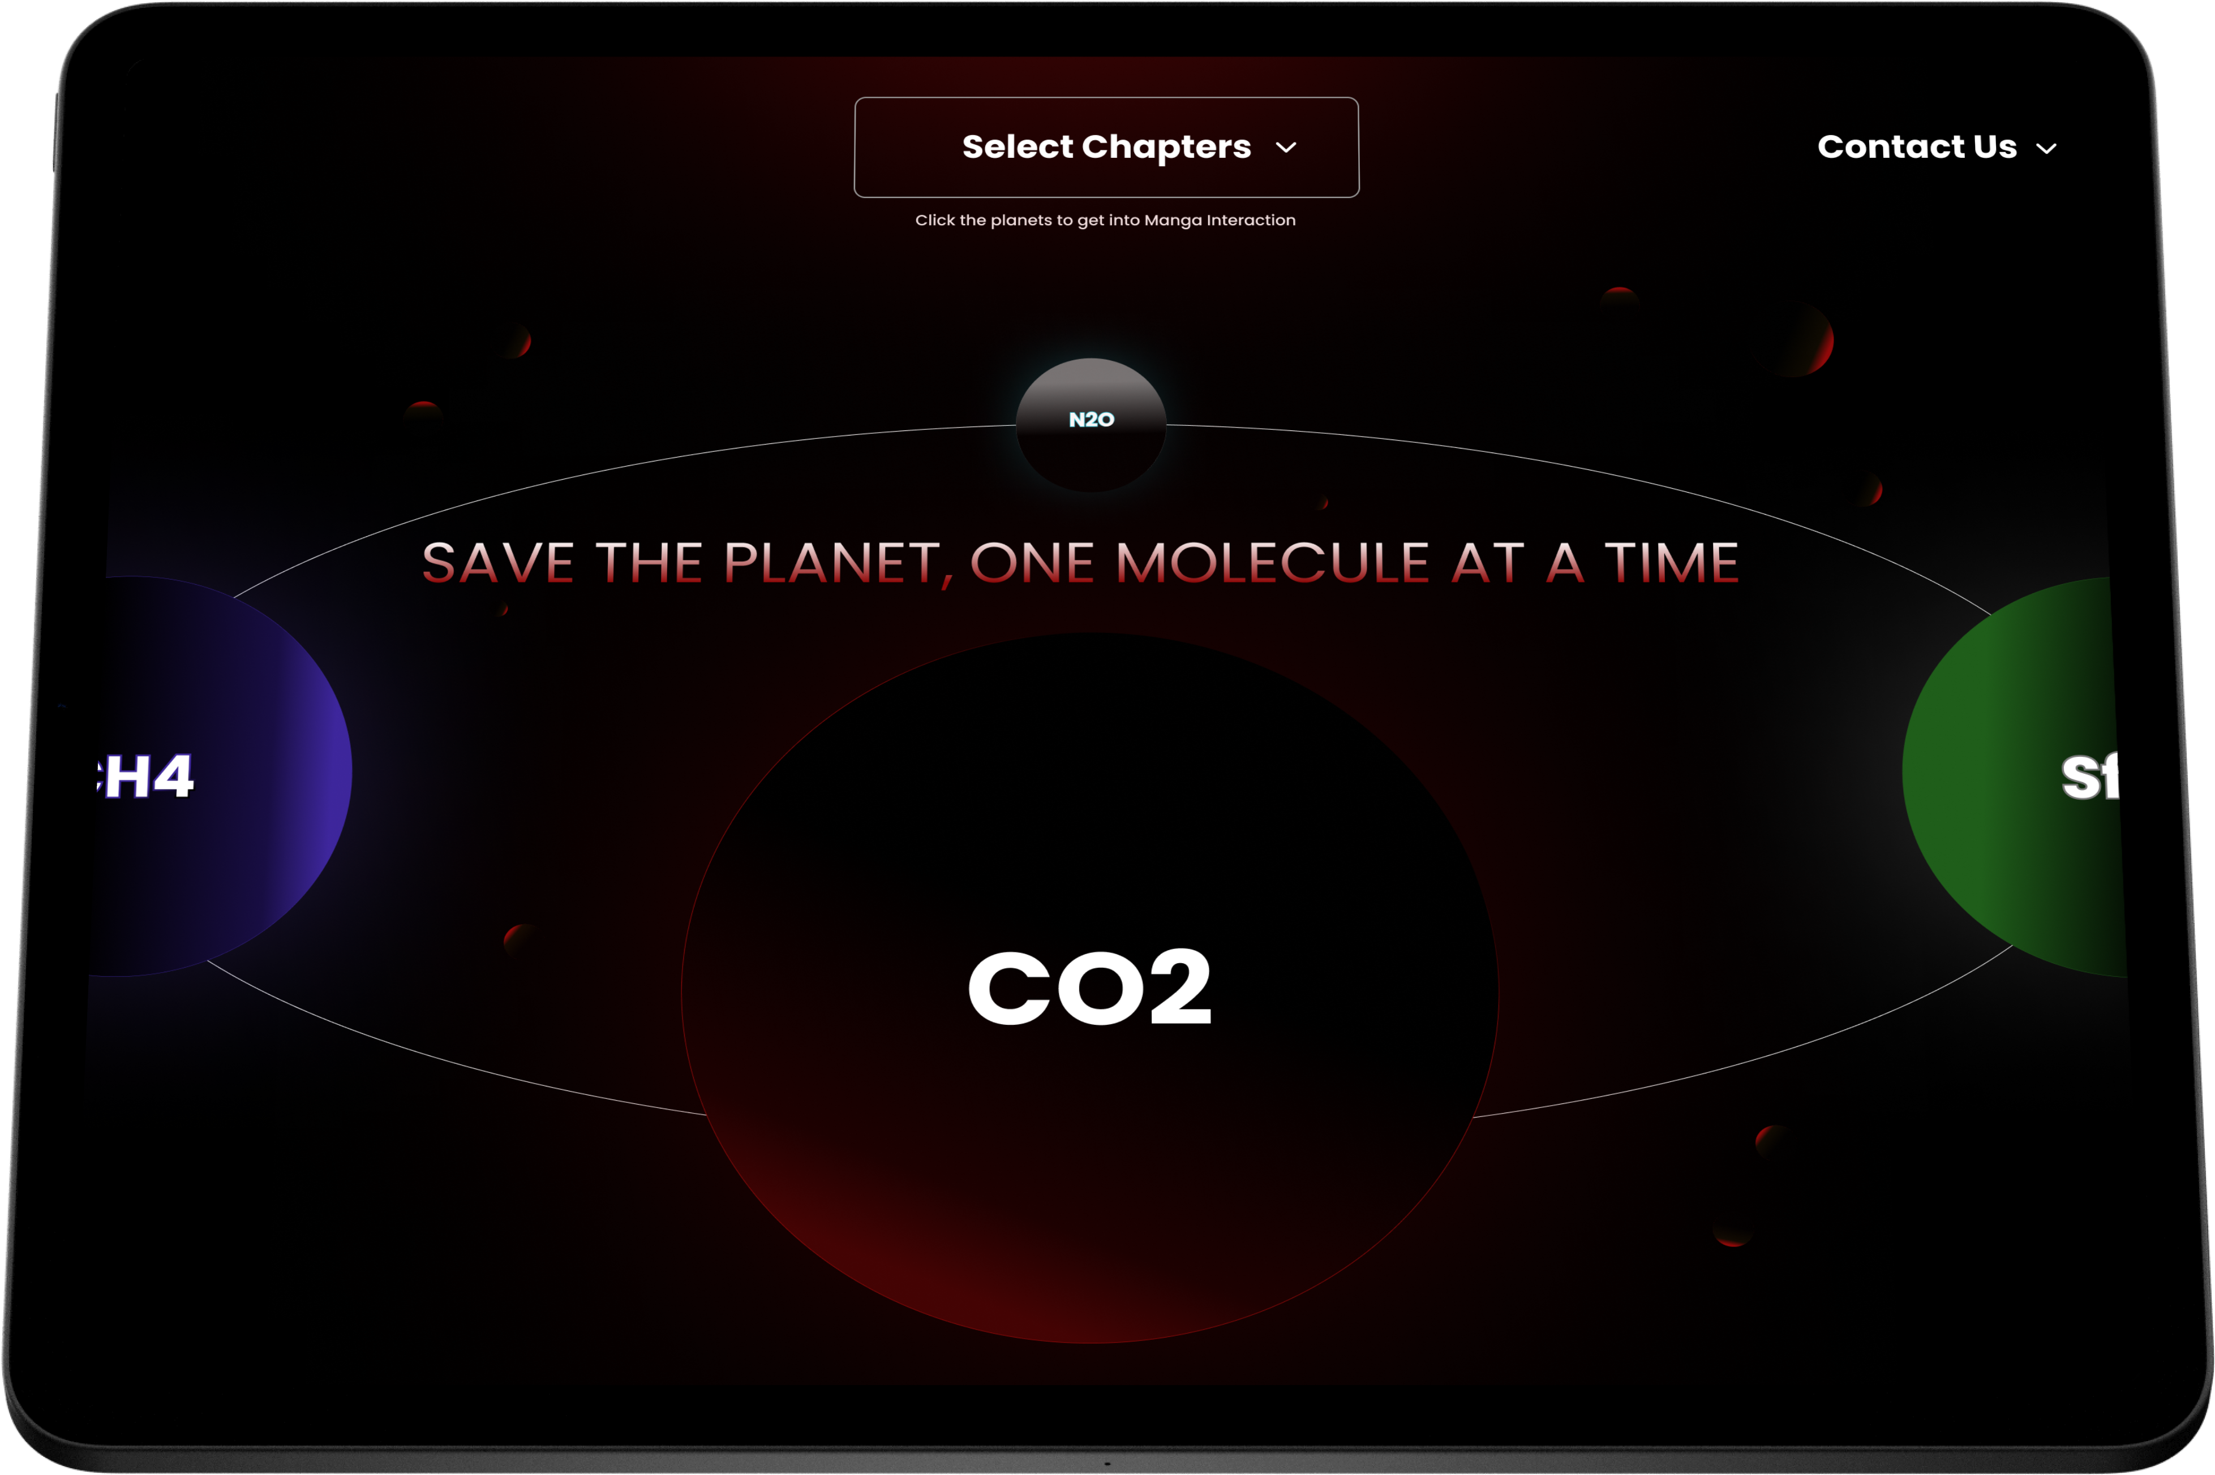
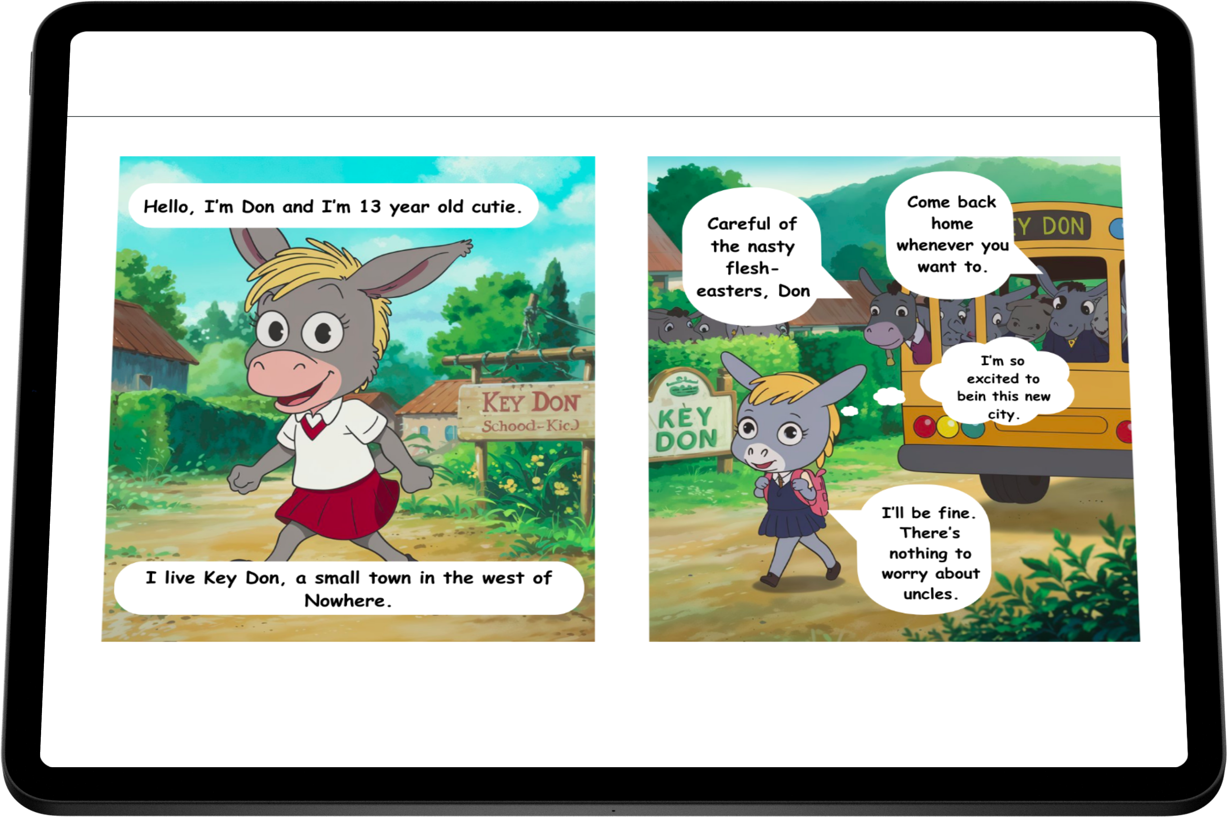
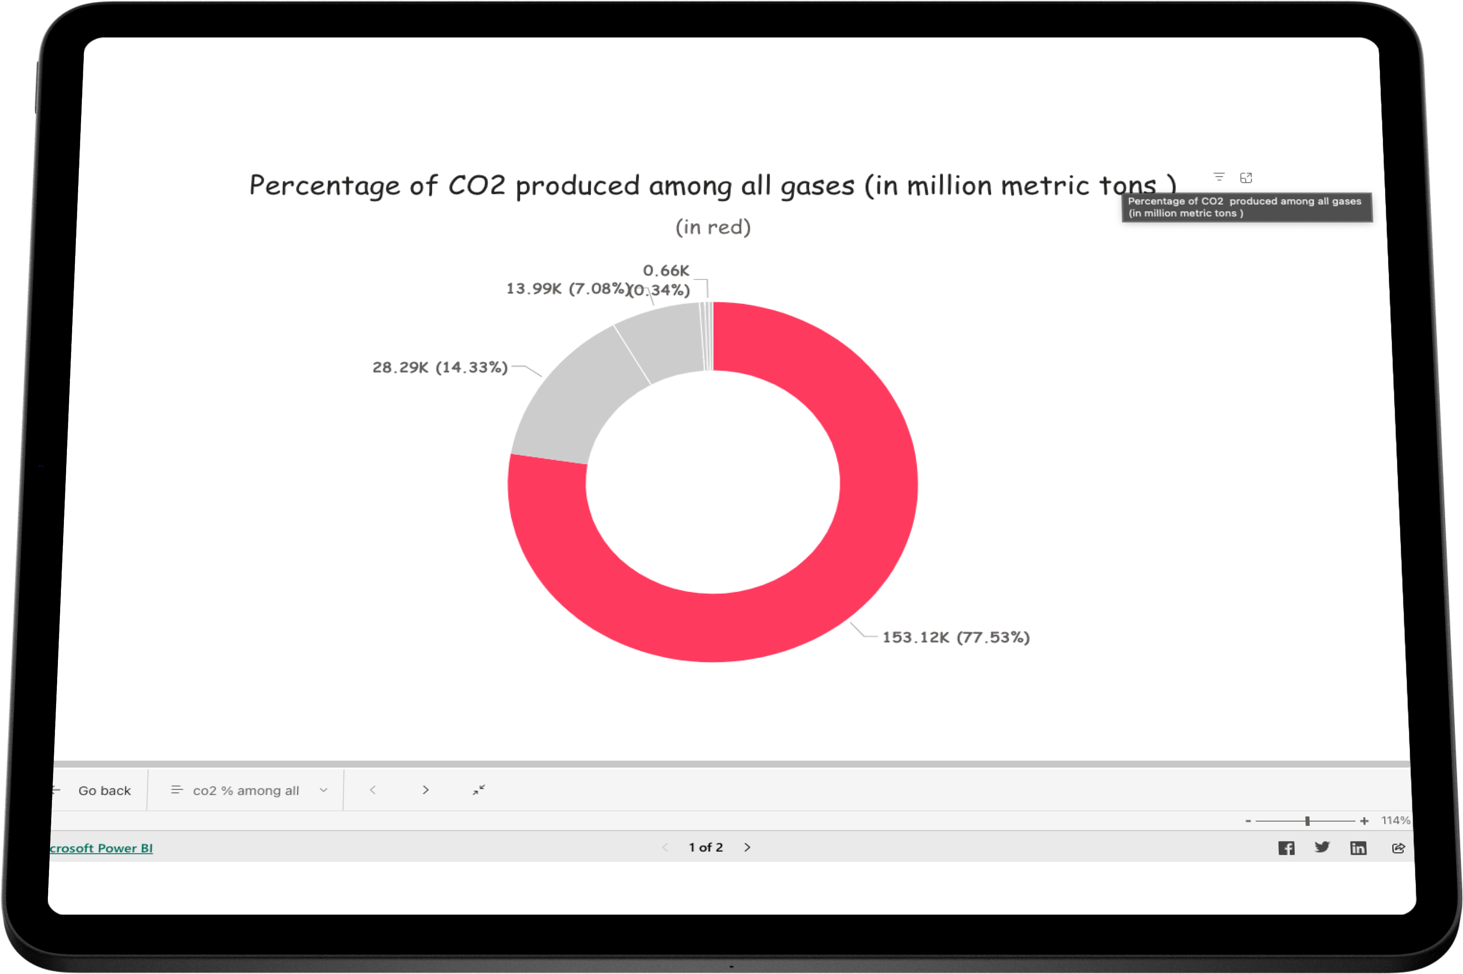
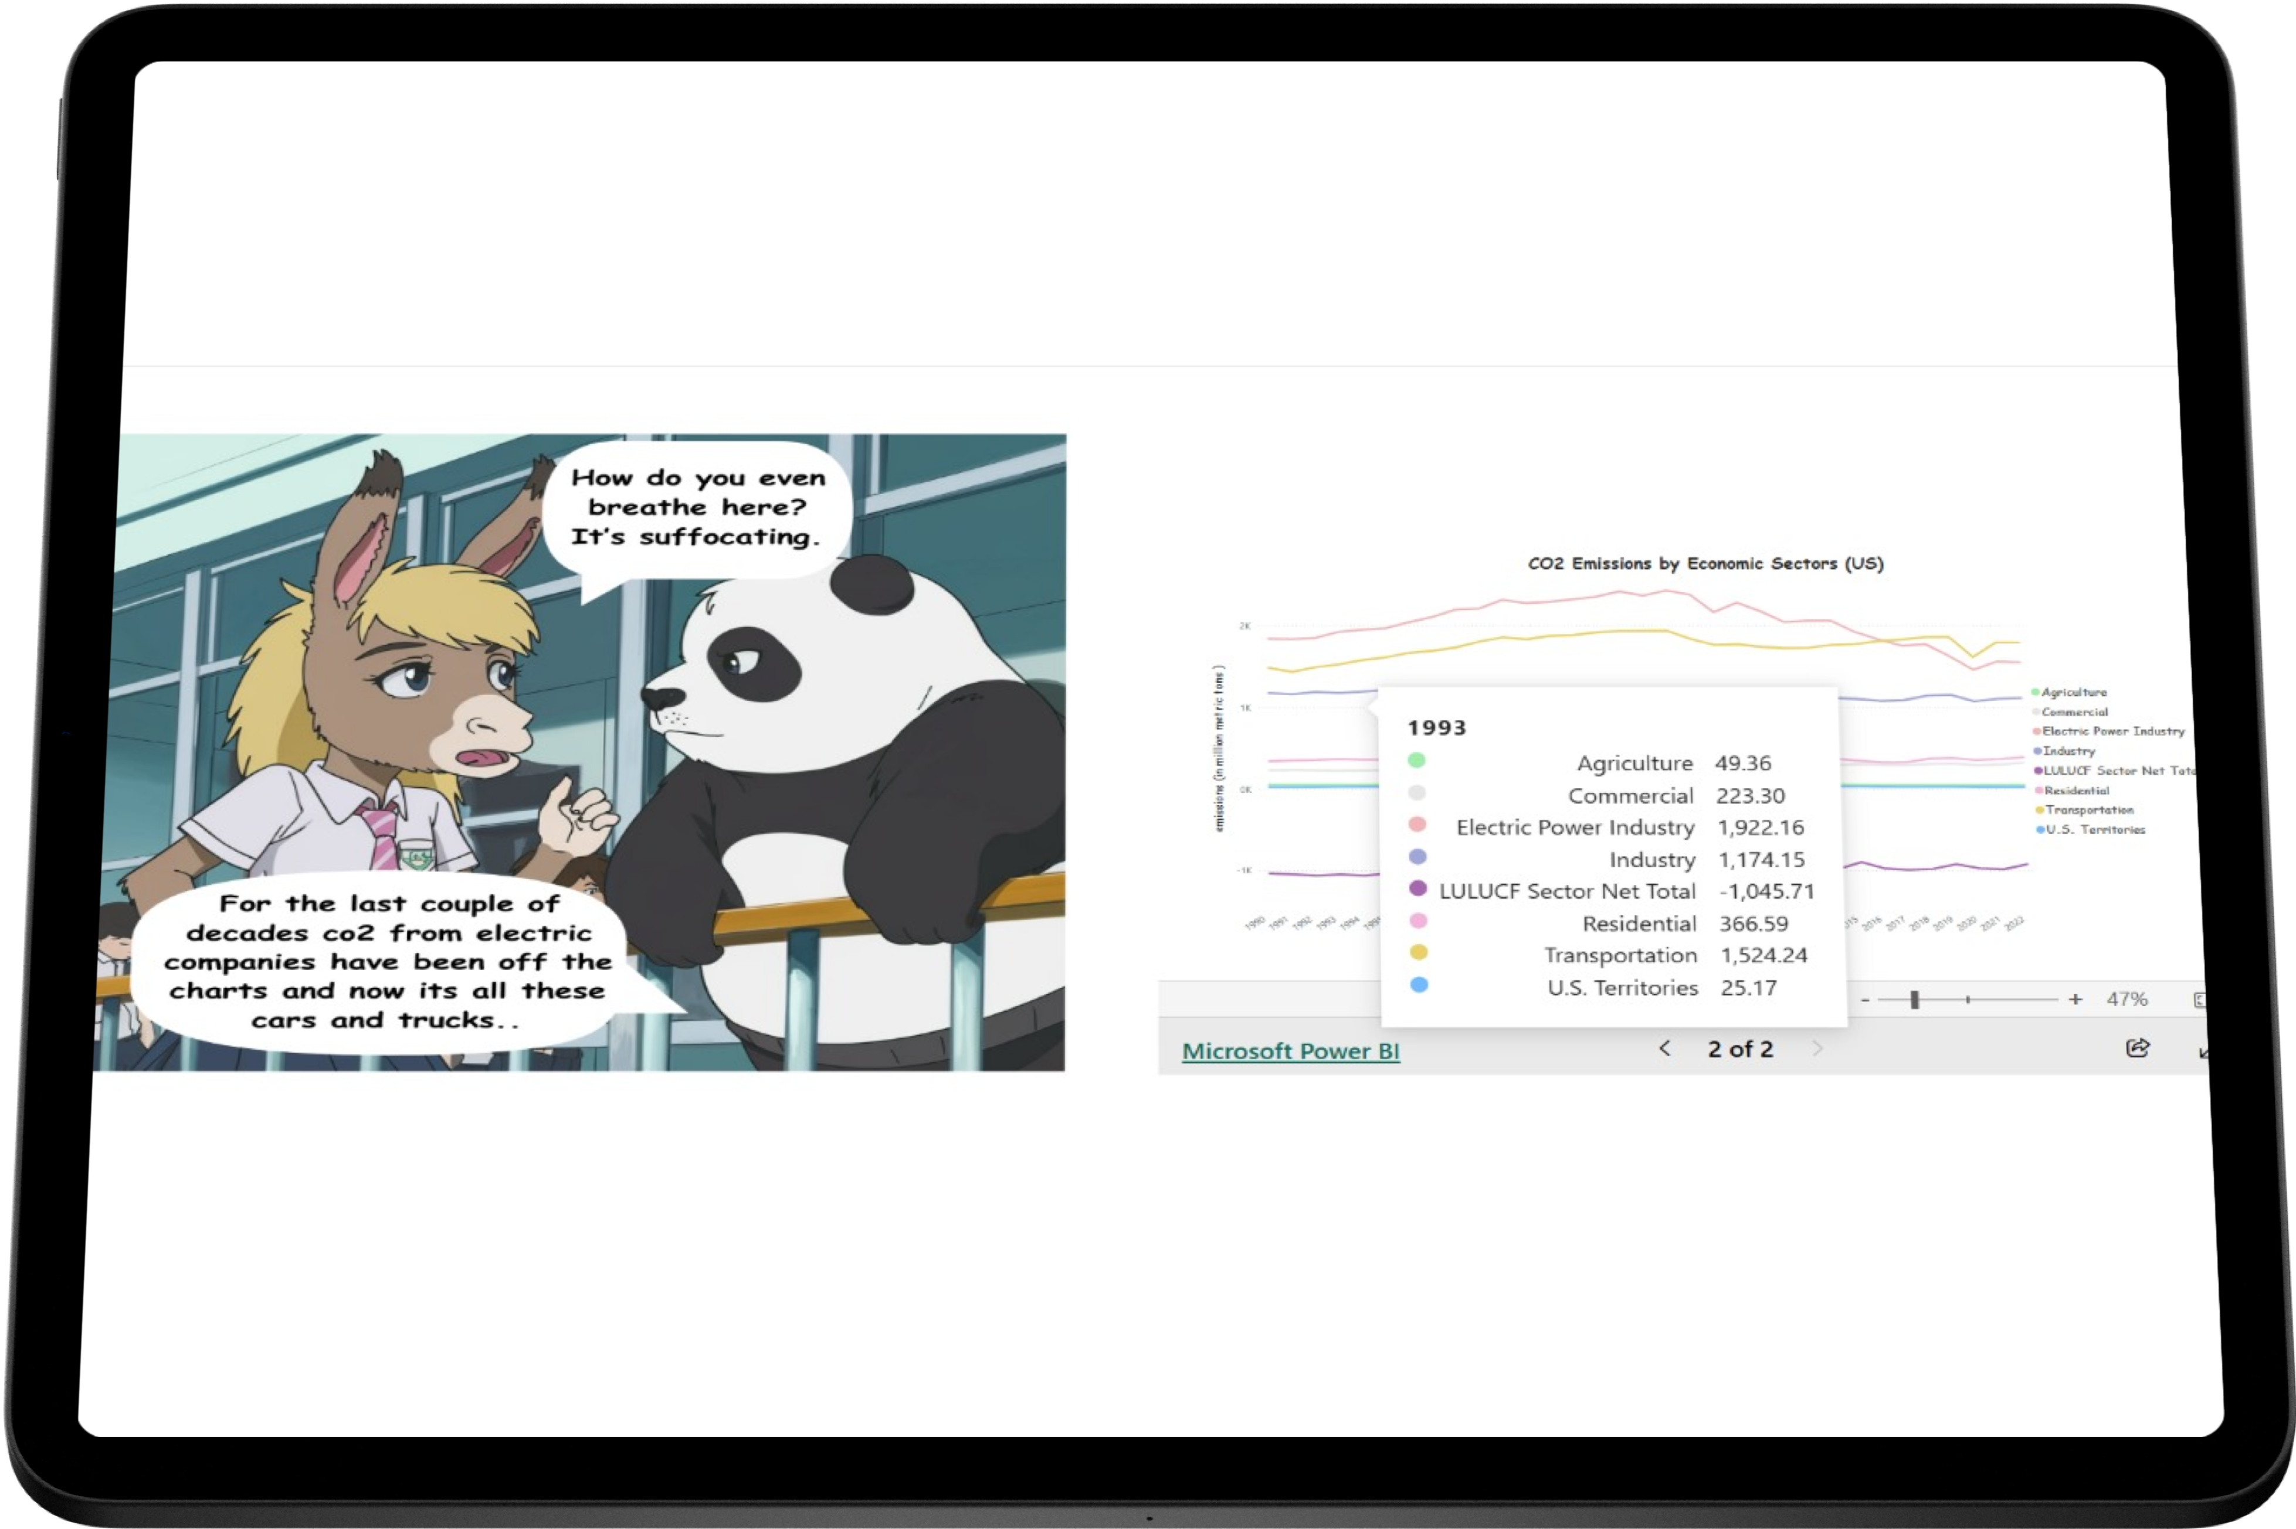
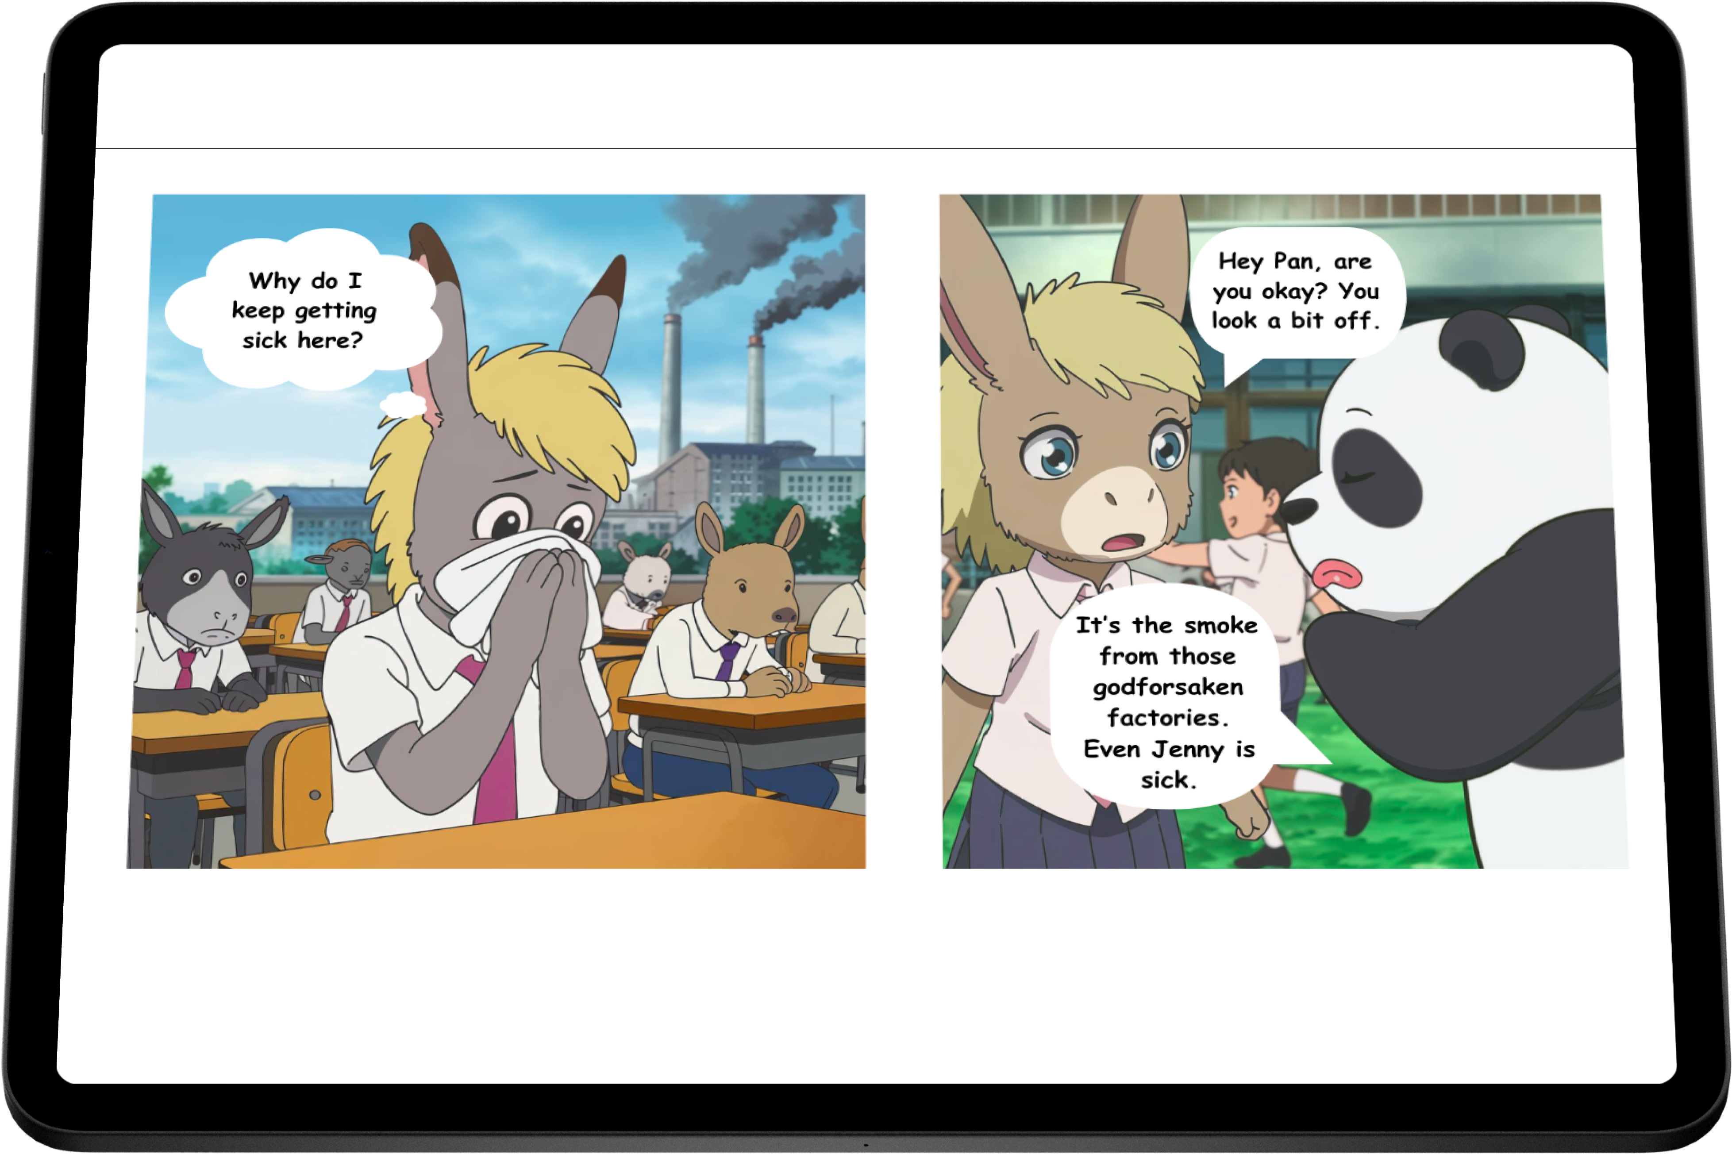
Wireframes/Mock diagrams of the proposed solution (optional)

Slide 10
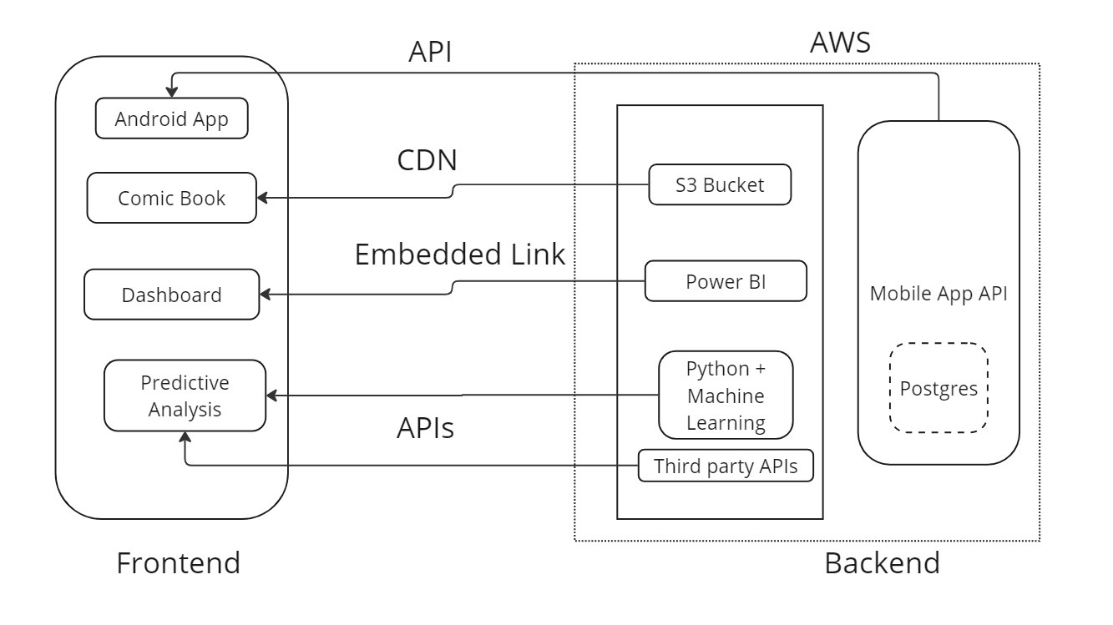
Architecture diagram of the proposed solution

Slide 11
Technologies to be used in the solution
Analytical tools
Python
Power BI
Excel
UI/UX Design
Figma
AdobeXD
Framer
Frontend React.js
CSS
HTML
JavaScript
Mobile App Frontend
React native
Backend Python
Django
FB Prophet
Sarimax
AI Comic
Ideogram
Canva
Later will use Huggingface/ Leonardo AI
Deployment Render/ AWS

Slide 12
Estimated implementation cost (optional)
Hosting: 10k -15k

Slide 13
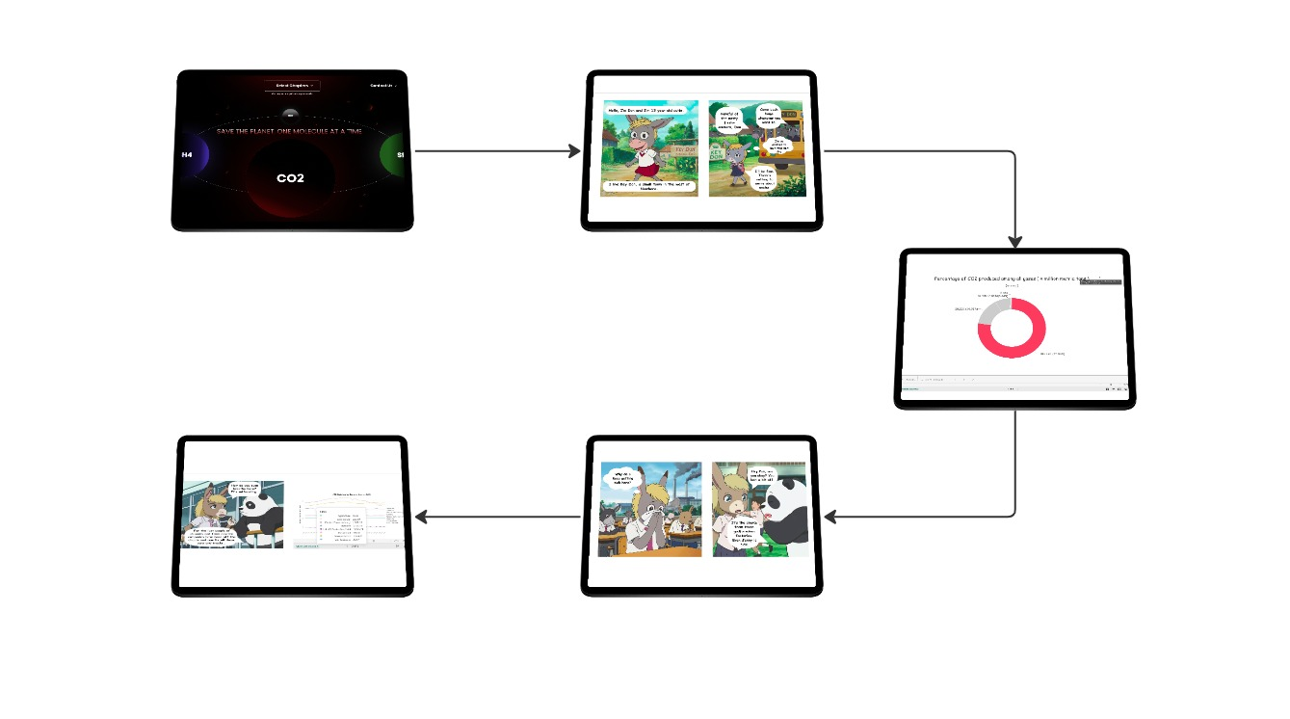
Snapshots of the prototype

Slide 14
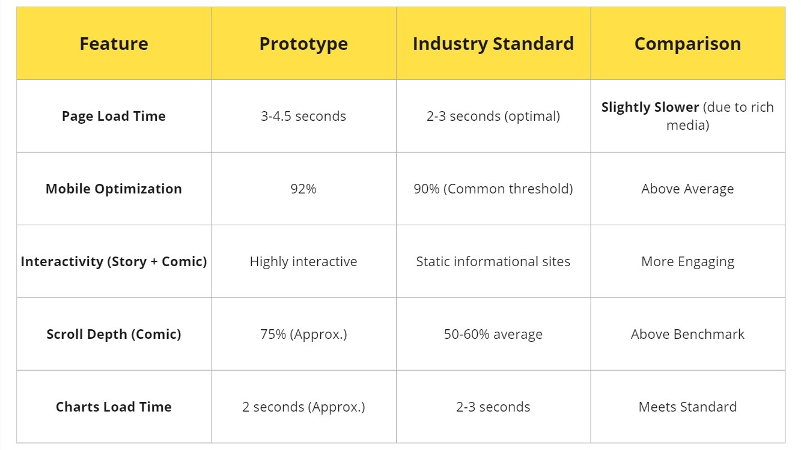
Prototype Performance report/Benchmarking

Slide 15
Additional Details/Future Development (if any)
Detailed analysis of all other potent gases
GHG calculator App:
Calculate individual GHG footprint.
Users can compare their GHG footprint score with global averages making the impact more personal.
Recommends lifestyle changes based on GHG score to lower the emissions. For example, switch to a cycle if you go to a nearby gym. That’s cardio + less pollution.
Integrating global datasets to make visualizations internationally relevant since climate change is a global issue.
Display current data from several APIs
Carbon intensity
Global Climate Indicators: temperature anomalies, sea-level rise, ice-melt, etc.
Responsive layout

Slide 16
Provide links to your:
GitHub Public Repository
Demo Video Link (3 Minutes)
Final Product Link
GitHub: DjangoMustang GitHub repository
Video link: YouTube demo video
Website link: Interactive comic website

Slide 17





Screenshots for proof of registration in official NASA website

Slide 18


